Slide 1
Systematic Testing
(Scratching the surface)
The art of economic testing...
Henrik Bærbak Christensen

Slide 2
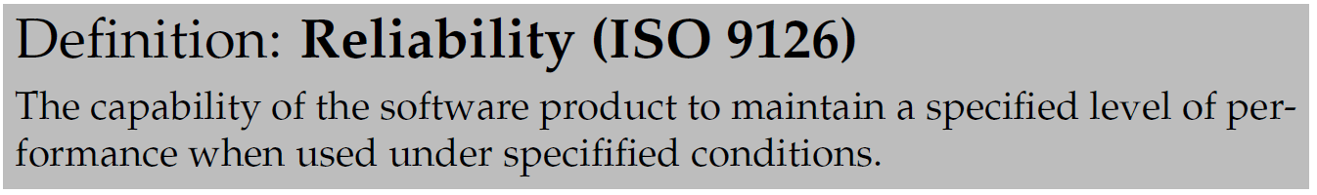
What is reliability?
If there is a defect, it may fail and is thus not reliable.
Thus:
  Reduce number of defects
  … will reduce number of failures
  … will increase reliability
Henrik Bærbak Christensen

Slide 3
Discussion
True?
  Find example of removing a defect does not increase the system’s reliability at all
  Find example of removing defect 1 increase reliability dramatically while removing defect 2 does not
Henrik Bærbak Christensen
Notes:
A friend came with a word document – ready to hand-in – but some plug-in prevented word from saving the document

Slide 4
All defects are not equal!
So – given a certain amount of time to find defects (you need to sell things to earn money!):
What kind of defects should you correct to get best return on investment?
Henrik Bærbak Christensen

Slide 5
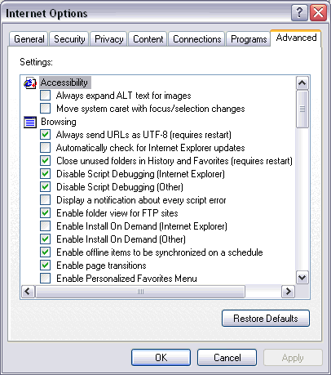
Example
IE has an enormous
amount of possible
configurations!
Imagine testing all
possible combinations!
Which one would you
test most thoroughly?
Henrik Bærbak Christensen
Henrik Bærbak Christensen

Slide 6
Testing techniques
Henrik Bærbak Christensen

Slide 7
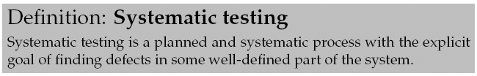
One viewpoint
The probability of defects is a function of the code complexity. Thus we may identify three different testing approaches:
  No testing. Complexity is so low that the test code will become more complex. Example: set/get methods
  Explorative testing: “gut feeling”, experience. TDD relies heavily on ‘making the smart test case’ but does not dictate any method.
Henrik Bærbak Christensen
Henrik Bærbak Christensen

Slide 8
Destructive!
Testing is a destructive process!!!
  In contrast to almost all other SW processes which are constructive!
Human psychology
  I want to be a success
    The brain will deliver!
      (ok, X-factor shows this is not always the case…)
I will prove my software works
I will prove my software is really lousy
Henrik Bærbak Christensen

Slide 9
Morale:
When testing, reprogram your brains
I am a success if I find a defect.
The more I find, the better I am!
Henrik Bærbak Christensen

Slide 10
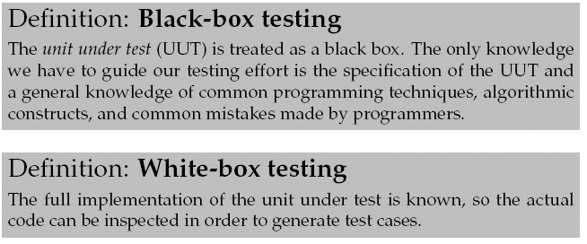
Our focus
There are a lot of different testing techniques.
Types:
Here – two black box techniques:
  Equivalence class partitioning
  Boundary value analysis
Henrik Bærbak Christensen
Henrik Bærbak Christensen

Slide 11
Equivalence Class Partitioning
Henrik Bærbak Christensen

Slide 12
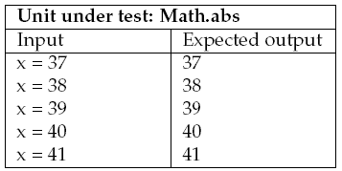
Consider
Math.abs(x): Absolute value of x
  If x is not negative, return x.
  If x is negative, return the negation of x.
Will these five test cases ensure a reliable implementation?
Henrik Bærbak Christensen

Slide 13
Two problems
A) what is the probability that x=38 will find a defect that x=37 did not expose?
B) what is the probability that there will be a defect in handling negative x?
Henrik Bærbak Christensen

Slide 14
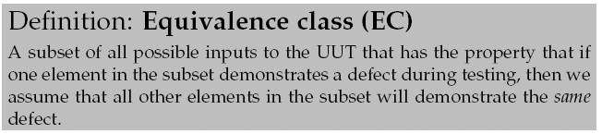
Core insight
We can find a single input value that represents a large set of values!
Henrik Bærbak Christensen

Slide 15
For Math.abs
ECs are subsets of the full input set.
-42
+39
-92431523
+37
EC-1
EC-2
X = - 42 | 42
Henrik Bærbak Christensen

Slide 16
The argumentation
The specification will force an implementation where (most likely!) all positive arguments are treated by one code fragment and all negative arguments by another.
  Thus we only need two test cases:
    1) one that tests the positive argument handling code
    2) one that tests the negative argument handling code
For 1) x=37 is just as good as x=1232, etc. Thus we simply select a representative element from each EC and generate a test case based upon it.
Henrik Bærbak Christensen

Slide 17
Note
Systematic testing ...
does not mean
  Systematically find all defects and guaranty none are left!!!
does mean
  Systematically derive a small test case with high probability of finding many defects!!!
Henrik Bærbak Christensen

Slide 18
Specifically
Systematic testing cannot in any way counter malicious programming
  Virus, easter eggs, evil-minded programmers
  (really really lousy programmers)
Henrik Bærbak Christensen

Slide 19
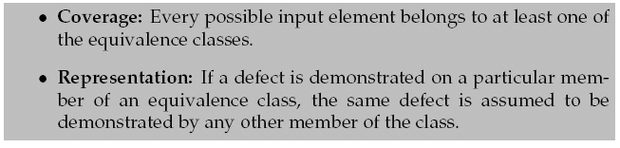
A sound EC partitioning
For our ECs to be sound:
Henrik Bærbak Christensen

Slide 20
Exercise
Coverage? Representation?
-42
+39
-92431523
+37
EC-1
EC-2
Henrik Bærbak Christensen

Slide 21
Exercise
The classic blunder at exams!
  Representation = two values from the same EC will result in the same behaviour in the algorithm
Argue why this is completely wrong!
  Consider for instance the Account class’ deposit method…
    account.deposit(100);
    account.deposit(1000000);
Henrik Bærbak Christensen

Slide 22
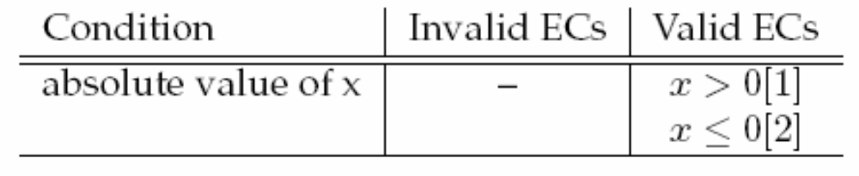
Documenting ECs
Math.abs is simple. Thus the ECs are simple.
This is often not the case! Finding ECs require deep thinking, analysis, and iteration.
Document them!
Equivalence class table:
Henrik Bærbak Christensen

Slide 23
Invalid/Valid ECs
Some input values make an algorithm give up, bail out, or compute answer immediately:
  Sqrt(0); file.open(“nonexisingfile”);division(4/0);
Input values that leads to abnormal processing/giving up we classify as belonging to invalid ECs.
Those input values that process normally we say belong to valid ECs.
Henrik Bærbak Christensen

Slide 24
Finding the ECs
Often tricky…
Henrik Bærbak Christensen

Slide 25
Reality
Example: Backgammon move validation
  validity = v ( move, player, board-state, die-value )
    is Red move (B1-B2) valid on this board given this die?
  Problem:
    multiple parameters: player, move, board, die
    complex parameters: board state
    coupled parameters: die couples to move!
      EC boundary is not a constant!
Henrik Bærbak Christensen
Henrik Bærbak Christensen

Slide 26
A process
To find the ECs you will need to look carefully at the specification and especially all the conditions associated.
  Conditions express choices in our algorithms and therefore typically defines disjoint algorithm parts!
  And as the test cases should at least run through all parts of the algorithms, it defines the boundaries for the ECs.
… And consider typical programming techniques
  Will a program contain if’s and while’s here?
Henrik Bærbak Christensen
Henrik Bærbak Christensen

Slide 27

Partitioning Heuristics
1) If you have a range of values specification
  make 3 ECs:
    [1] in range valid
    [2] above range invalid
    [3] below range invalid
Ex. Standard chess notation/ is “a8” or “x17” valid positions?
  Column range: a-h Row range: 1-8
Henrik Bærbak Christensen
Henrik Bærbak Christensen

Slide 28

Partitioning Heuristics
2) If you have a set, S, of values specification
  make |S|+1 ECs
    [1]..[|S|] one for each member in S valid
    [|S|+1 for a value outside S invalid
Ex. PayStation accepting coins
  Set of {5, 10, 25} cents coins
Henrik Bærbak Christensen
Henrik Bærbak Christensen

Slide 29

Partitioning Heuristics
3) If you have a boolean condition specification
  make 2 ECs
Ex. the first character must be a letter
the object reference must not be null
  you get it, right?☺
Henrik Bærbak Christensen
Henrik Bærbak Christensen

Slide 30
Partitioning Heuristics
4) If you question the representation property of any EC, then repartition!
  Split EC into smaller ECs
Examples: shortly ☺
Henrik Bærbak Christensen
Henrik Bærbak Christensen

Slide 31
From ECs to Test cases
Henrik Bærbak Christensen

Slide 32
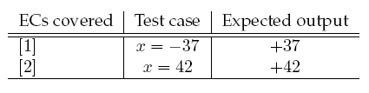
Test case generation
For disjoint ECs you simply pick an element from each EC to make a test case.
Extended test case table
Augmented with a column showing which ECs are covered!
[2]
[1]
Henrik Bærbak Christensen

Slide 33
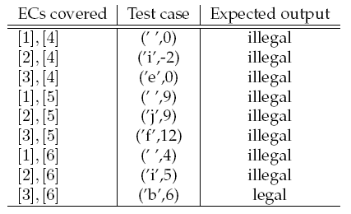
Usual case
ECs are seldom disjoint – so you have to combine them to generate test cases.
Ex. Chess board validation
Henrik Bærbak Christensen

Slide 34
Combinatorial Explosion
Umph! Combinatorial explosion of test cases ☹.
Ex.
  Three independent input parameters foo(x,y,z)
  Four ECs for each parameter
    That is: x’s input set divided into four ECs, etc.
Question:
  How many test cases?
Henrik Bærbak Christensen

Slide 35
Combinatorial Explosion
Answer: 4³ = 64 test cases…
TC1: [ECx1],[ECy1],[ECz1]
TC2: [ECx1],[ECy1],[ECz2] …
TC4: [ECx1],[ECy1],[ECz4] …
TC5: [ECx1],[ECy2],[ECz1] …
TC9: [ECx1],[ECy3],[ECz1] …
TC64: [ECx4],[ECy4],[ECz4]
Henrik Bærbak Christensen

Slide 36
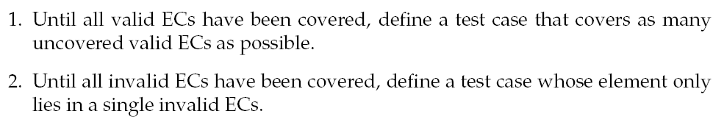
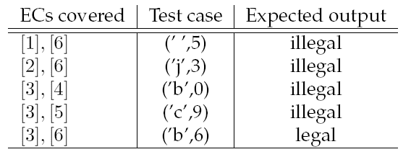
Myers Heuristics
Often, generate test cases like this is better:
Rule 2
Rule 1
Henrik Bærbak Christensen

Slide 37
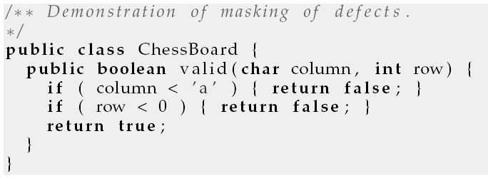
Why Rule 2?
Due to masking
  One correct test masks a later incorrect test
Ex.
Test case (‘ ‘,0) will pass which is expected
  Code deemed correct, but this is a wrong conclusion!
Henrik Bærbak Christensen

Slide 38
Why Rule 1?
You may combine as many valid ECs as possible and cover it with only a single test case until all valid ECs are exhausted…
Why?
Because I must assume that all elements from ECs are used to compute the final result. Any defects will thus most likely show up even if the defect only relate to one element.
Ex. bankdayNumberInYear(int month, int day)
  return 30*month+day
Henrik Bærbak Christensen
Notes:
Even a single testcase like (3,1) = March 1st will detect that the algorithm above is wrong because the two parameters are both used in computation. Another wrong algorithm like “30*(month-1)+day-1” would also be detected only by a single testcase etc.

Slide 39
The Process
Henrik Bærbak Christensen

Slide 40
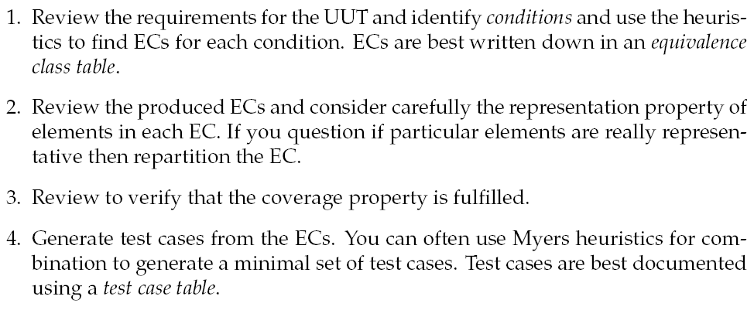
Revisited…
Henrik Bærbak Christensen

Slide 41
An Example
Phew – let’s see things in practice
Henrik Bærbak Christensen

Slide 42
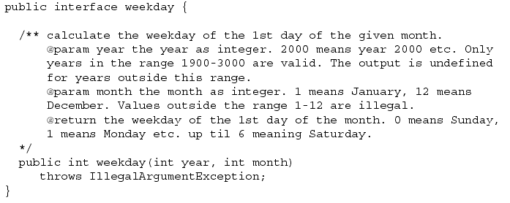
Example
Henrik Bærbak Christensen
Henrik Bærbak Christensen

Slide 43
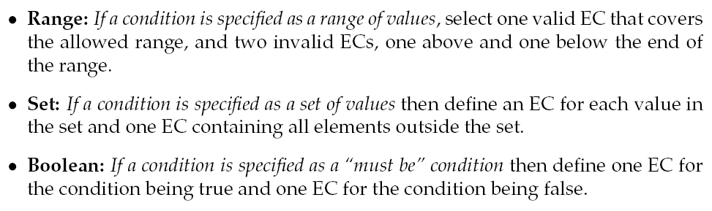
Exercise
Which heuristics to use on the spec?
Henrik Bærbak Christensen

Slide 44
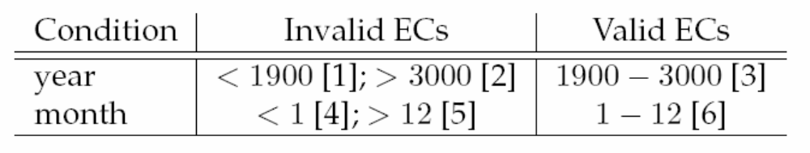
Process step 1
Result
Henrik Bærbak Christensen

Slide 45
Process step 2
Review and consider representation property?
Henrik Bærbak Christensen

Slide 46
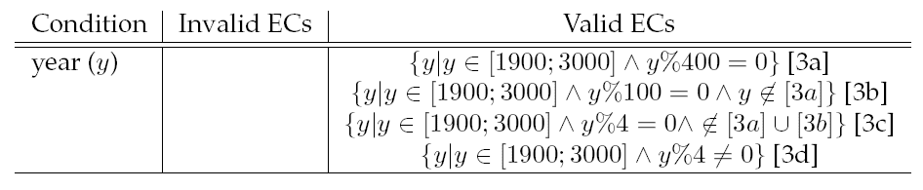

Damn – Leap years!
Nice to be an astronomer ☺
What about the months? Let’s play it safe…
Henrik Bærbak Christensen

Slide 47
Process step 3
Coverage?
Henrik Bærbak Christensen

Slide 48
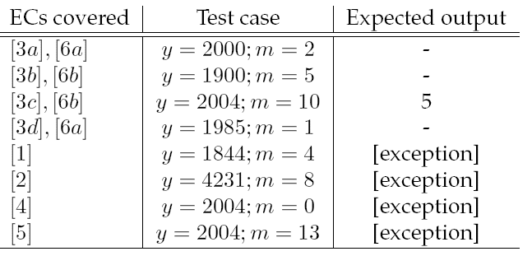
Process step 4
Generate, using Myers
Conclusion: 8 test cases for a rather tricky alg.
Henrik Bærbak Christensen

Slide 49
Example 2
Henrik Bærbak Christensen

Slide 50
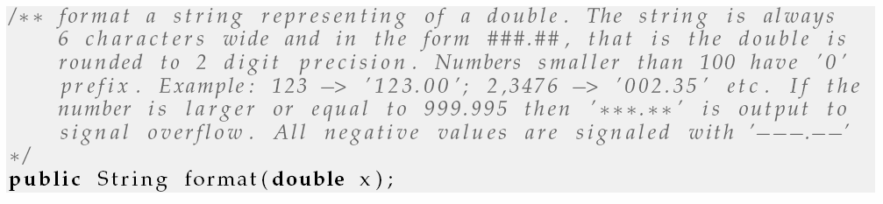
Formatting
Note! Most of the conditions do not really talk about x but on the output.
Henrik Bærbak Christensen

Slide 51
Exercise
What do we do?
Range? Boolean? Set?
Valid / Invalid ECs?
Henrik Bærbak Christensen

Slide 52
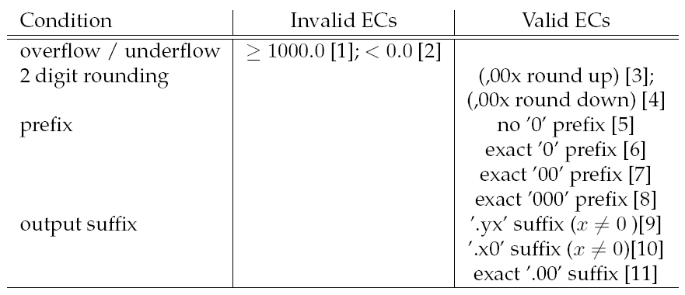
My analysis
0.0 <= x < 1000.0 [1a]
Henrik Bærbak Christensen

Slide 53
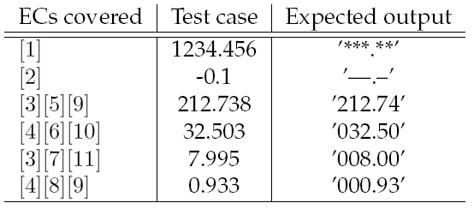
Test cases
Henrik Bærbak Christensen

Slide 54
Boundary value analysis
Henrik Bærbak Christensen

Slide 55
Boundary value analysis
Experience shows that test cases focusing on boundary conditions have high payoff.
Some that spring into my mind is
  iteration over a C array at its max size
  ”off by one” errors in comparisons
    if ( x <= MAX_SIZE ) and not if ( x < MAX_SIZE )
  null as value for a reference/pointer
Henrik Bærbak Christensen
Henrik Bærbak Christensen

Slide 56
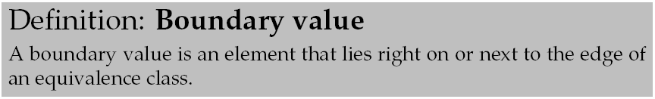
Complements EP analysis
Ex. Formatting has a strong boundary between EC [1] and [1a]
  0.0 (-> ‘000.00’) and -0.000001 (-> ‘---.--’)
It is thus very interesting to test x=0.0 as boundary.
Henrik Bærbak Christensen
Henrik Bærbak Christensen

Slide 57
Discussion
Henrik Bærbak Christensen

Slide 58
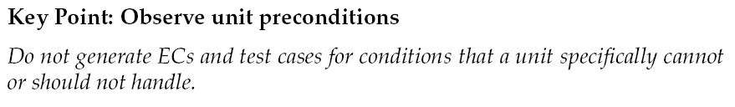
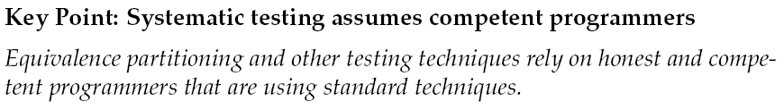
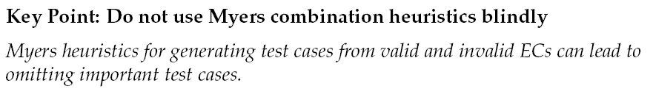
A few key points
Henrik Bærbak Christensen

Slide 59
Summary
Equivalence Class Partitioning
  EC = set of input elements where each one will show same defect as all others in the same set (representation)
  Find ECs, use Myers to generate test cases.
Boundary analysis
  be sceptical about values at the boundaries
  Especially on the boundary between valid and invalid ECs
Henrik Bærbak Christensen
Henrik Bærbak Christensen

